Slide 1
INTRODUCTIOIN TO ENGINEERING DRAWING:
A language to describe
Shape
Size
Fit
Assembly

Slide 2
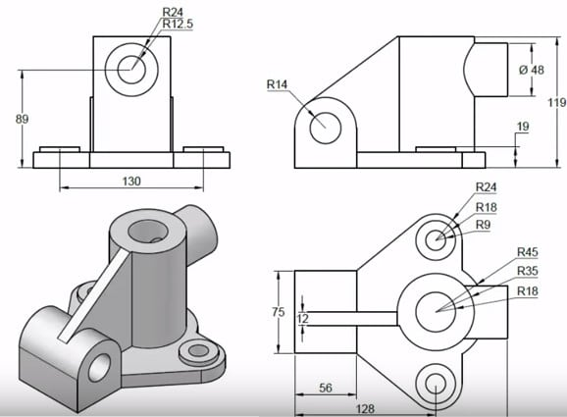
TYPES OF DRAWING:
Detail Drawings
To describe the shape, size, fit and finish of each and every part in detail for production purposes.

Slide 3
TYPES OF MEASURING SYSTEMS:
English
Feet and Inches
Metric
Meters and Millimeters

Slide 4
DRAWING INSTUMENTS AND THEIR USES:
Drawing Board
Serves as a flat drawing surface to attach a paper to.
Drafting Media
Paper
Film (Tracing Paper)
Standard Sizes are:
USA size, inches Closest International size, mm
A (8.5 x 11.0) A4 (210 x 297)
B (11.0 x 17.0) A3 (297 x 420)
C (17.0 x 22.0) A2 (420 x 594)
D (22.0 x 34.0) A1 (594 x 841)
E (34.0 x 44.0) A0 (841 x 1189)

Slide 5
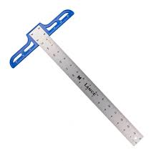
Pencils
Classification according to lead hardness is:
Hard grades Medium grades Soft grades
9H Hardest 3H Hardest 2B Hardest
8H 2H 3B
7H H 4B
6H F 5B
5H HB 6B
4H Softest B Softest 7B Softest
Eraser
T Square
For drawing horizontal lines and provide a supporting/sliding edge for set-squares and other stencils.

Slide 6
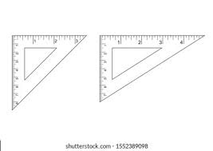
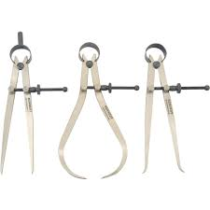
Set-Squares
For drawing vertical and angular lines
Scales
Linear scales (English and Metric)
Cardboard scales (For reducing and increasing size)
Diagonal scales (For measuring fractions)
Protractor (For measurement of angles)
Compass with Extender
For drawing circles and circular arcs
Divider
For transferring measurements and for dividing lines into any number of equal parts.

Slide 7
TYPES OF LINES USED IN ENGINEERING DRAWING:

Slide 11
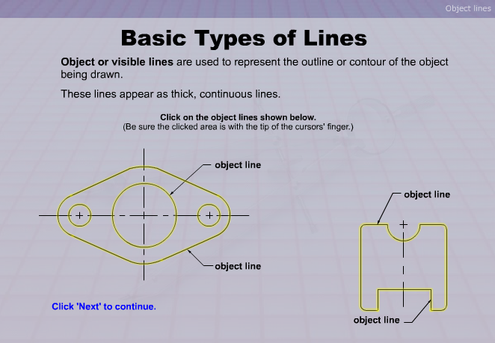

Slide 12
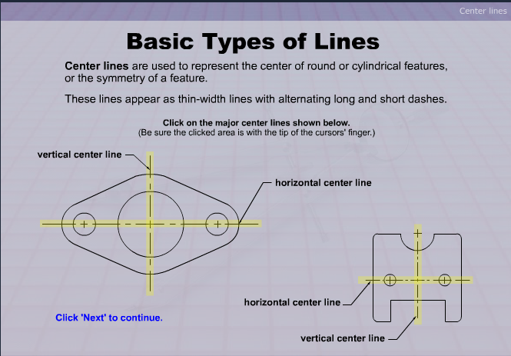

Slide 13
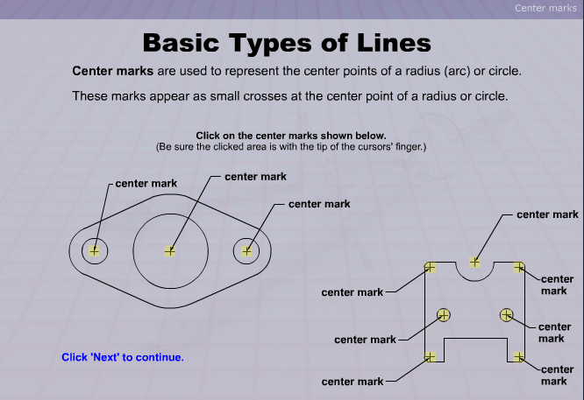

Slide 14
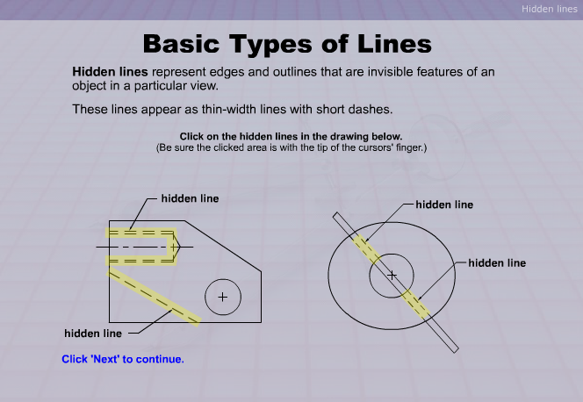

Slide 15
SCALES
SCALES
Reducing Scales
For objects drawn smaller than their actual size
Enlarging Scales
For objects drawn larger than their actual size

Slide 16
Representative Fraction (R.F.)
The ratio of the length of the drawing to the actual length of the object represented
Represented in the form of X : Y
X is the unit on the drawing whereas Y is the representation on the actual object.
A scale of 1:2 means 1 unit of length on the drawing representing 2 units of length of the object.
A scale of 2:1 means 2 units of length on the drawing representing 1 unit of length of the object.

Slide 17
TYPES OF SCALES
Metric Scales
Based on the decimal system
Reducing scales usually used are:
1:2, 1:2.5, 1:5, 1:10, 1:20, 1:25, 1:50, 1:100, 1:200, 1:250 etc.
Enlarging scales usually used are:
2:1, 2.5:1, 5:1, 10:1, 20:1, 25:1, 50:1, 100:1, 200:1, 250:1 etc.
Inch-Foot (English) Scales
Based on decimal and fraction system
Reducing and Enlarging scales have similar R.F. to Metric scales in the decimal system.
Fraction system has R.Fs of the type
1:2, 1:3, 1:4, 1:6, 1:12 etc. or vice versa.

Slide 18
INCH DIVISIONS
Fractions (8ths)

Slide 19
INCH DIVISIONS
Fractions (8ths)

Slide 20
INCH DIVISIONS
Fractions (8ths)

Slide 21
INCH DIVISIONS
Fractions (8ths)

Slide 22
INCH DIVISIONS
Fractions (8ths)

Slide 23
INCH DIVISIONS
Fractions (8ths)

Slide 24
Decimal (10ths)

Slide 25
Decimal (10ths)

Slide 26
Decimal (10ths)

